Slide 1
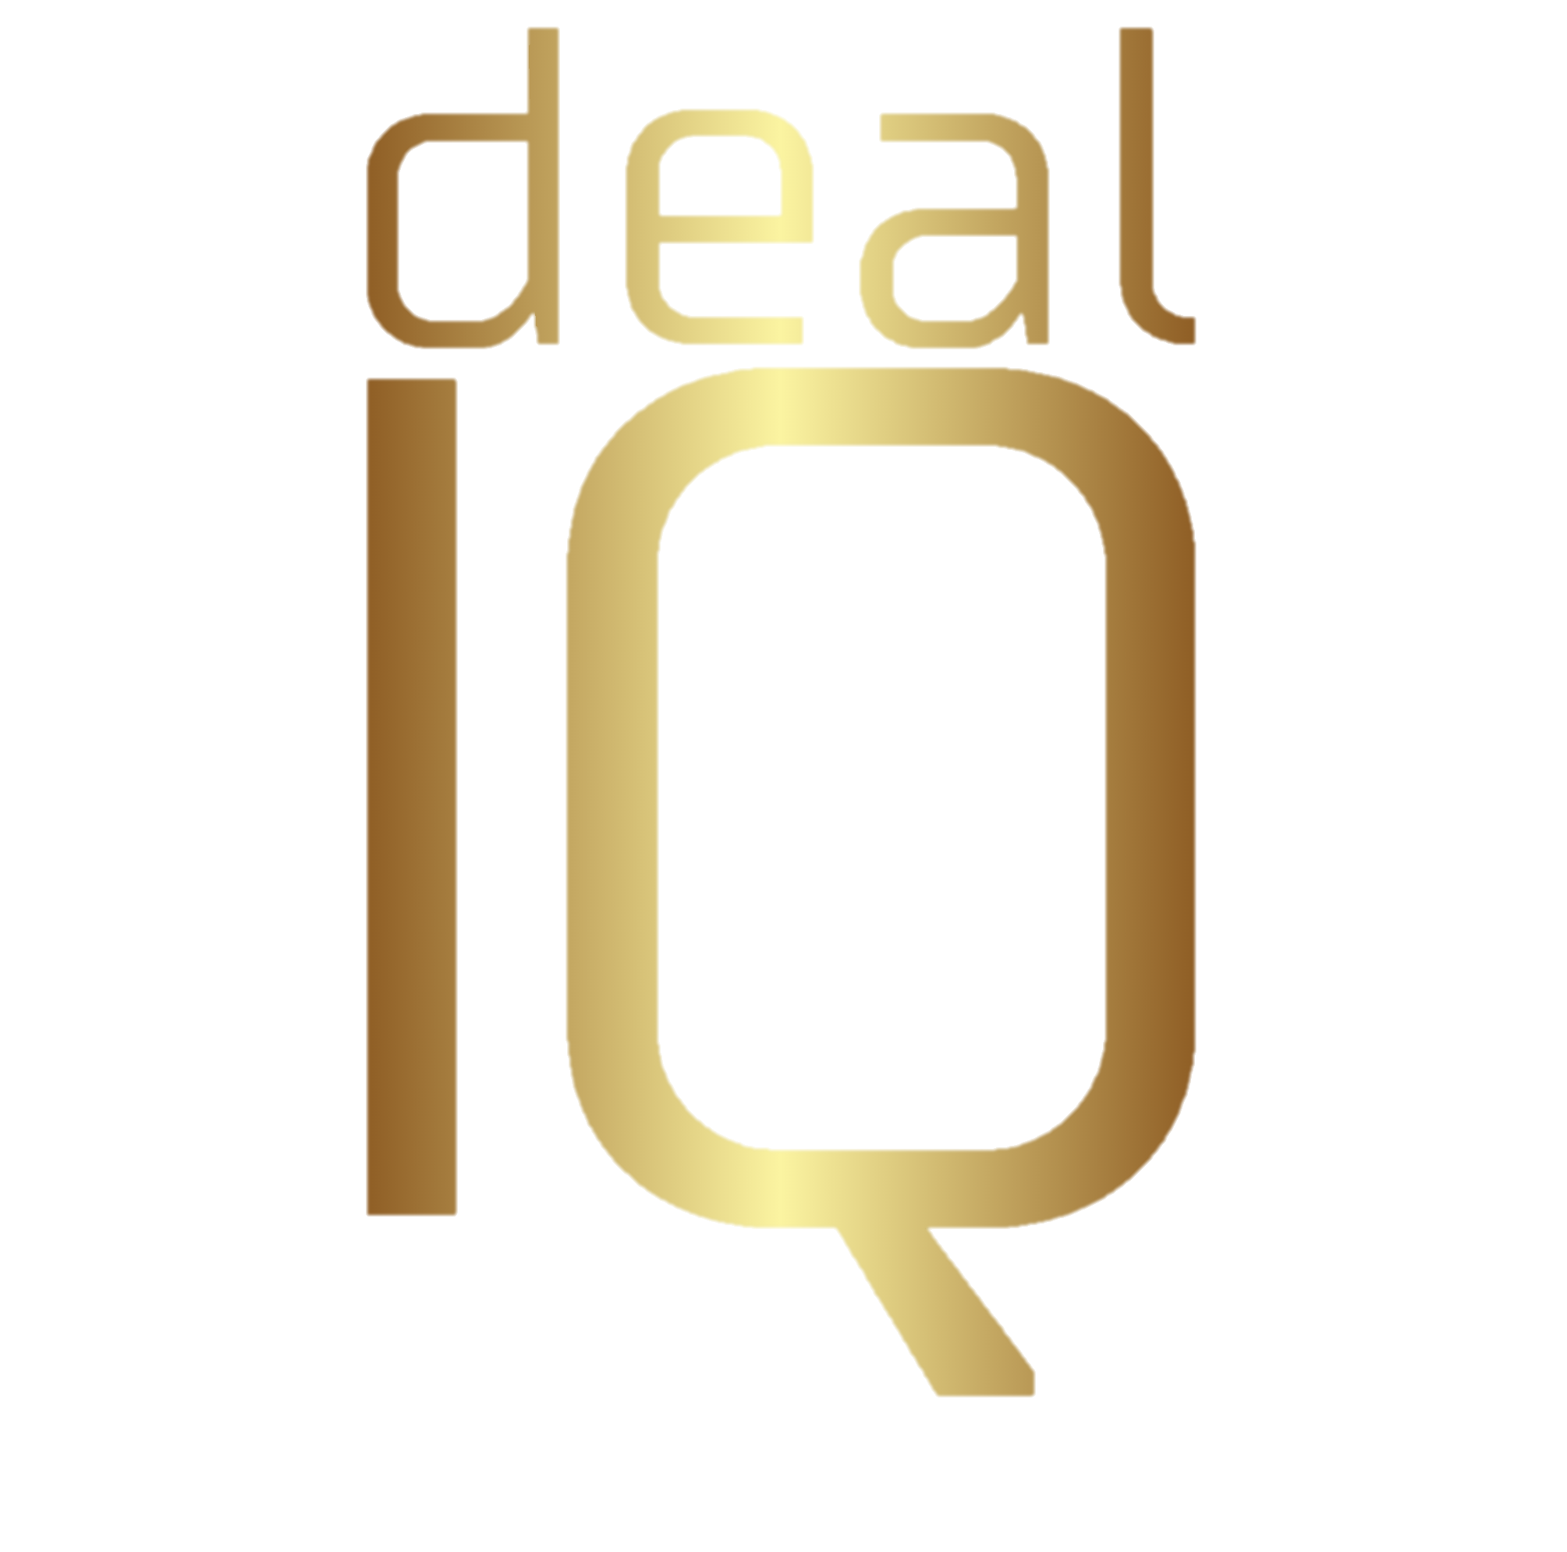
behavioural economics
Leveraging Human Bias in Negotiation
WORLD CC • 2 SEPTEMBER 2025 • MELBOURNE
PRIYA BHASIN

Slide 2
negotiation = the art of influencing decisions
Notes:
Have you ever walked out of a negotiation and thought “how did THAT happen??”
We've all been there.
Negotiation is fundamentally about influencing decisions.
But you can’t truly influence decisions unless you understand how people actually make them.
Our entire professional training focuses on logical frameworks, structured processes, concession trading.
But the training completely overlooks the science of why and how people actually make decisions.
That got skipped. It's like playing chess without knowing how the pieces move.
Enter behavioural economics - the science that shows people are predictably irrational.
Nobel Prize-winning research that proves we make emotional decisions first and then rationalise them.
Today, I'm bringing these game-changing insights to your negotiations.
We’ll need to QUICKLY dive into the neuro-science first - how your brain is actually wired to make decisions.
Then we'll explore how this wiring creates predictable cognitive biases that can derail even your most structured deals.
But here's the superpower part: the best negotiators don't fight these biases - they dance with them. [PAUSE]
Each bias gets a practical tip - how to spot them, use them, and defend against them. QR codes on the slides give you everything - cheat sheets, reading lists, the works.
Ready to unlock your negotiation superpower? Let's dive in.

Slide 3
35,000 decisions a day
95% made below your level of consciousness
Notes:
You make about 35,000 decisions every day. [PAUSE]
That means during this talk, you’ll make about 1,400.
But here's what's shocking—your conscious, rational brain?
The part you think is in charge?
It only makes 5% of those decisions [PAUSE]
Your subconscious does the rest. And it’s making some decisions right now, as you sit in that chair - deciding if you’re comfortable, if you’re hungry… even if the person next to you smells good. [smile, PAUSE]
And it doesn’t check in with your conscious brain. In fact, it dominates it.
Let me prove to you how your subconscious overrides your logic.
I want you to tell your conscious brain something important:
THE NEXT IMAGE IS COMPLETELY STATIC.
No movement whatsoever.
Ready?
CLICK

Slide 4
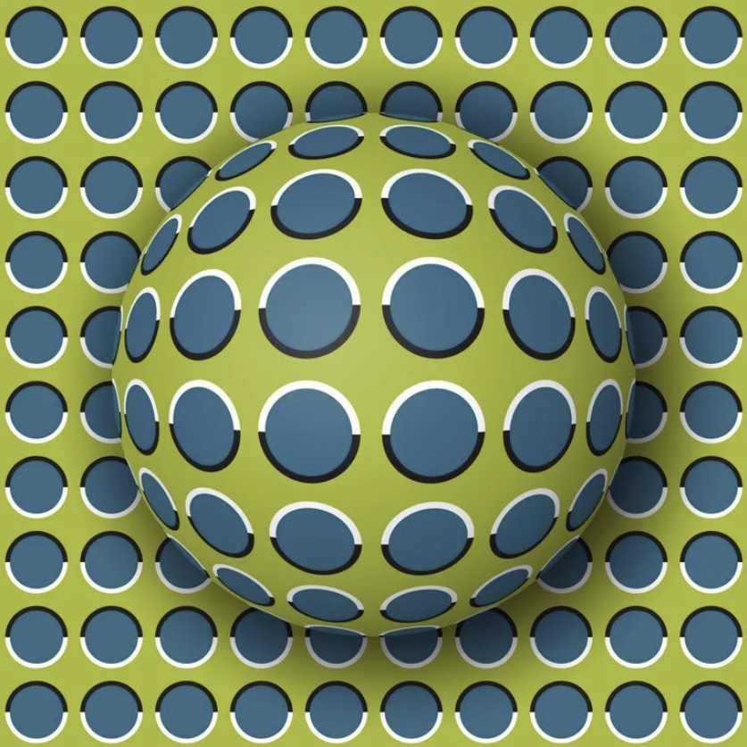
Notes:
Do you see movement?
You do—even though you just told your rational brain not to.
Cover part of the image with your hand, and the movement stops. Proof that it’s your brain, not my slide
Your subconscious just overrode what your conscious brain knew to be true.
Even when you warned your conscious brain to be alert to it. Pretty powerful, huh? And slightly terrifying
Why did it do that? Your subconscious brain sees motion because it's wired for survival, not accuracy.
For thousands of years, seeing motion that wasn't there was safer than missing a predator that was.
And we’re still running that outdated hunter-gather processing system in today’s modern world of boardrooms and uber eats.
And the same brain that sees movement in static images is the one that makes 95% of your decisions.
The one you take to the negotiation table.
A brain that can be tricked… nudged… and steered… without you even realising it.
So if you are like most people, who associate your sense of self with your conscious brain, the ask yourself this:
WHO OR WHAT IS REALLY IN CHARGE OF YOUR DECISIONS???
[CLICK]

Slide 5
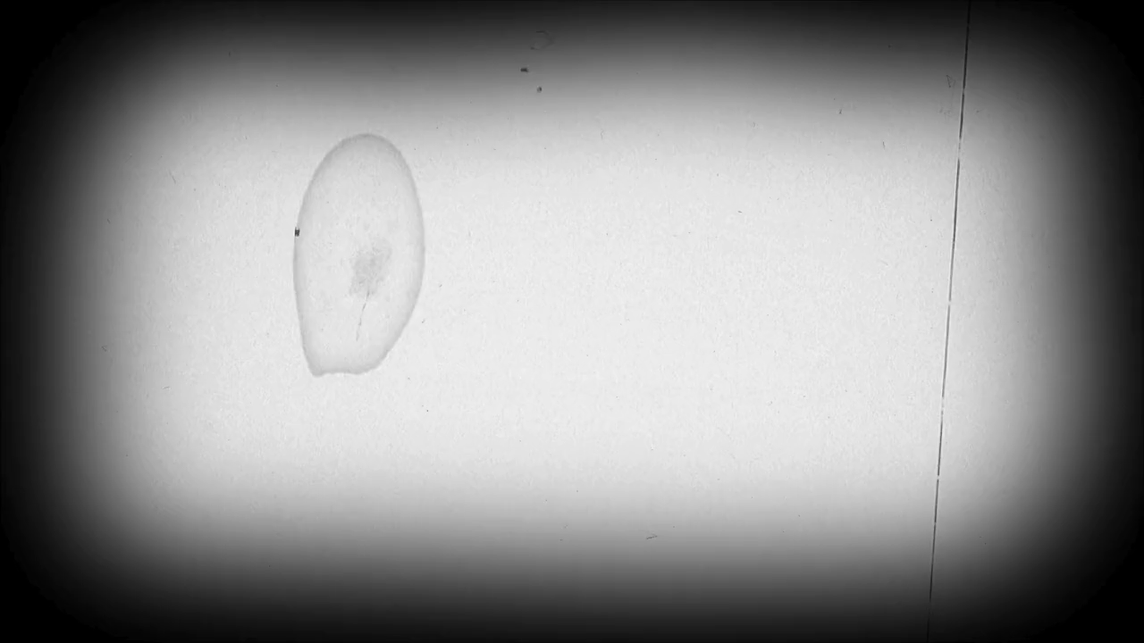

Slide 6
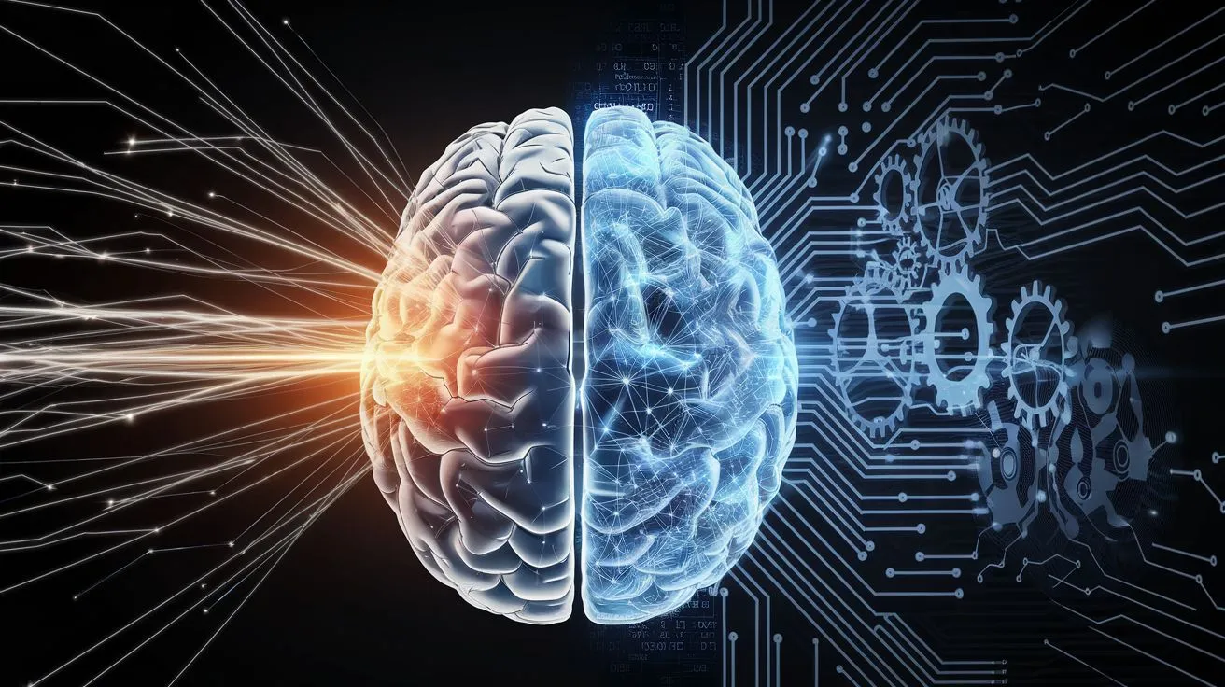
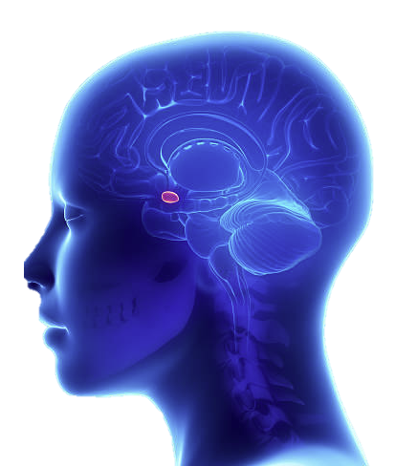
The Fast Brain
The Guy Running the Show
operating
95%
of the time
wired for survival
patterns & shortcuts
snap judgements
speed over accuracy
emotional
instinctive
always on
amygdala driven
processing
11 Million
bits per second
Notes:
Meet your Fast Brain — your subconscious, your gut instinct.
Click 1
This guy runs the show
It’s in charge 95% of the time
Click 2
It’s built for survival, so it relies on patterns, memories, and shortcuts.
It makes snap judgments
It’s Fast. Instinctive. Emotional.
It’s your Autopilot. Except You can’t switch it off. You can’t overrule it.
Click 3
And it’s terrifyingly fast
It can process 11 million bits of information - in a second. In one second. And it uses that information to make quick decisions. It favours speed over accuracy. It doesn’t stop to check facts – it just takes the data in front of it and decides what to process, what to edit, what to ignore. And if something’s missing – it will just make it up.. It’s a bit reckless really.
You see, your fast brain is powered by your amygdala, your fight-or-flight centre of your brain.
That primal survival wiring which kept our ancestors alive thousands of years ago hasn’t been upgraded. It still operates today in our modern world.
scanning, detecting and reacting to threat instantly. That’s why you saw ‘movement’ in that still image earlier. It wasn’t there. But your fast brain decided that it’s better to be wrong than eaten.
And this mismatch of old wiring, new world is what causes many of the cognitive biases we’ll talk about soon.
But for now, just remember that this part of your brain
The part that can be tricked… nudged… and steered…
That makes decisions without consultation, that disregards instructions like you just gave it a few minutes ago
Is always on
And it’s that brain that you take to the negotiation table.

Slide 7
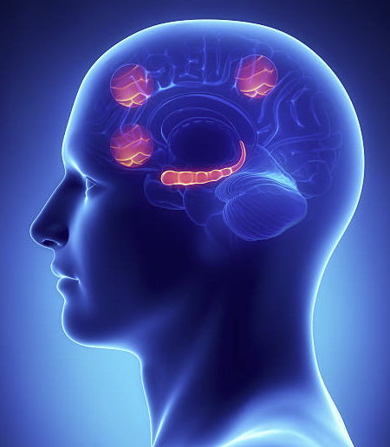
The Slow Brain
operating
5%
of the time
The “Occasional Guest Star”
deliberate
logical
process driven
energy-sapping
planning & reasoning
prefers accuracy to speed
prefrontal cortex
processing only
50
bits per second
Notes:
Now meet your Slow Brain. It’s the sensible older sister
It’s deliberate, logical, process-driven but painfully slow.
It’s powered by your prefrontal cortex — the part in charge of planning, reasoning, self-control.
Its main job? Learn new tasks….
then hand them off to the Fast Brain once they’re automatic.
This is the brain we like to think we use all the time
The truth? It only shows up when absolutely necessary — because running it constantly would drain too much energy.
So it only operates 5% of the time – like a guest star on a long-running TV show. [Click]
And while your Fast Brain chews through 11 million bits a second, your Slow Brain can only handle about 50.
Now that we know these 2 characters, let’s dive into the trouble they cause through their lack of communication [Click]

Slide 9
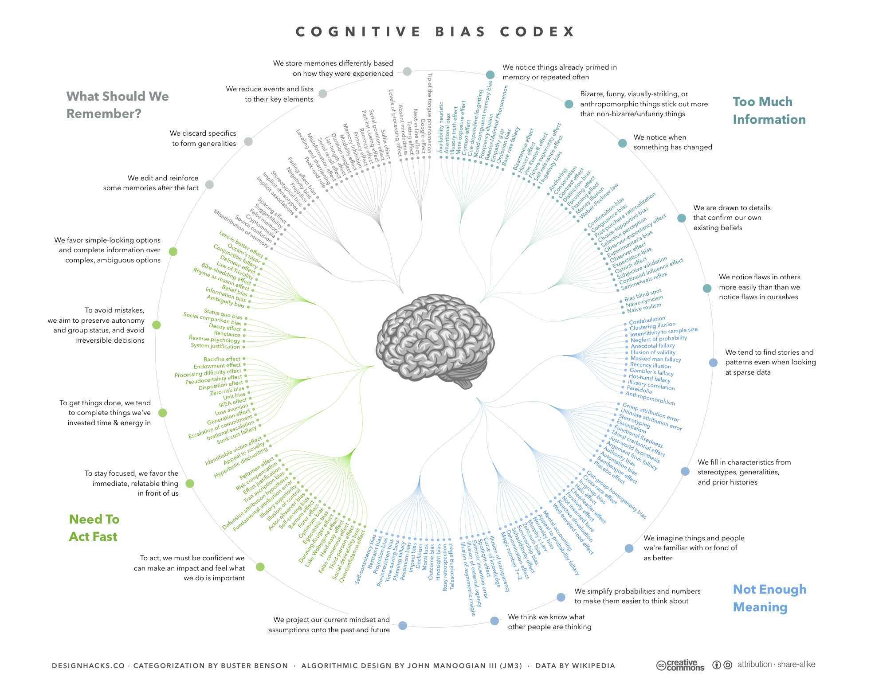
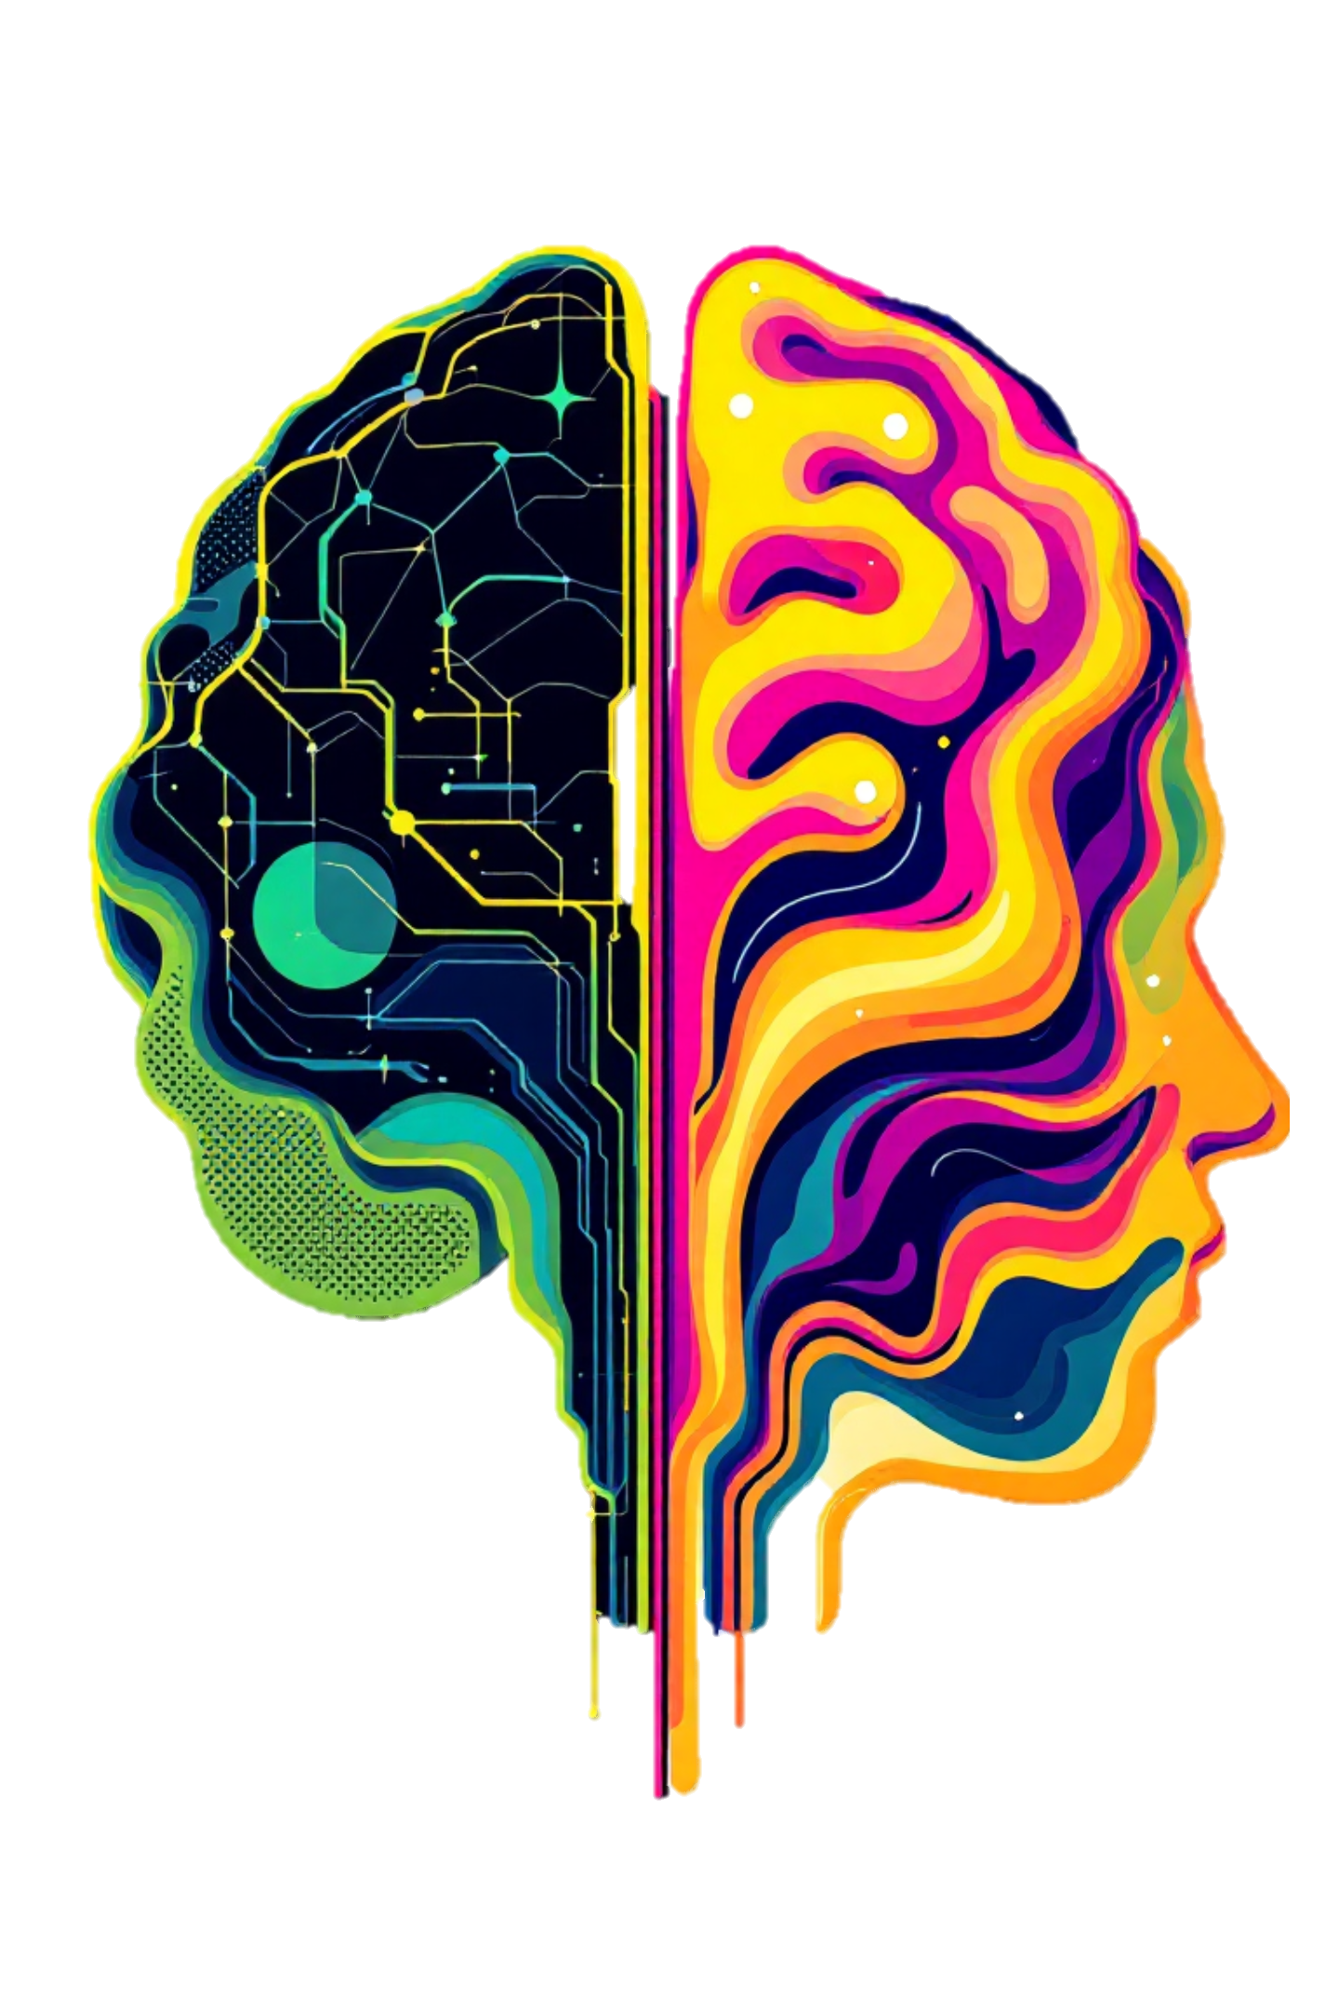
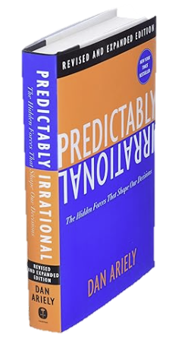
COGNITIVE BIASES IN NEGOTIATION
We all share the same biases…
Same Fast Brain shortcuts = Same cognitive Biases
Making us all.. PREDICTABLY IRRATIONAL
Predictably Irrational
Dan Ariely
Notes:
Those snap decisions your Fast Brain makes? They’re not random.
They follow patterns. Your brain takes the same shortcuts as everyone else — over and over.
Psychologists call these shortcuts cognitive biases.
And because we all share them, they make us… predictably irrational.
[Click]

Slide 10
Notes:
Here is the official codex of recognised cognitive biases - over 400 of them.
But don’t freak out, we only need to focus on a handful — the ones that consistently appear at the negotiation table
Today we’ll focus on 3 big areas – Anchoring, Loss Aversion and Choice Architecture
What matters to you as negotiators is being aware of these biases — knowing how to spot them, use them, and defend against them. [PAUSE]

Slide 11
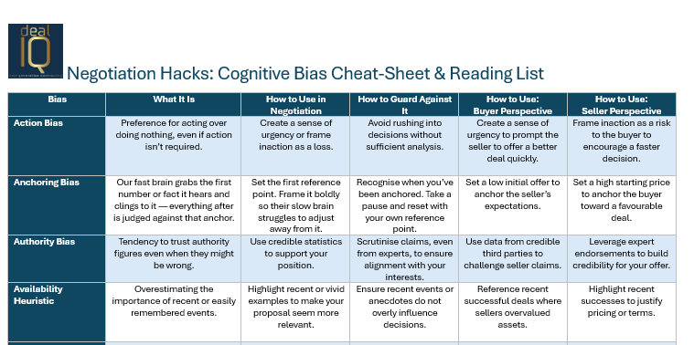
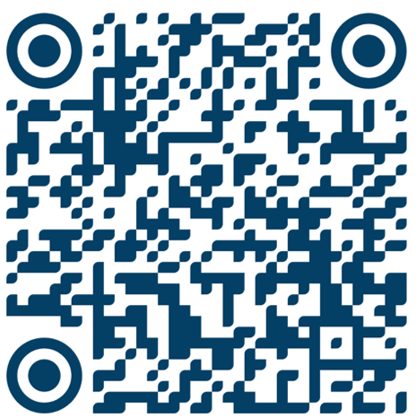
Get your extra resources here:
Negotiation tip: Look out for the boxes like this one for your Negotiation Tip!
Notes:
We are going to run through these quite fast. And for each one, I’ll share a key negotiation tip you can put into practice straight away. [PAUSE]
If you want to dive deeper, there’s a QR code on many of the slides. Scan it and you’ll get these slides, a reading list, and a Bias in Negotiation Cheat Sheet. [PAUSE]
So let’s get started… [CLICK]

Slide 12
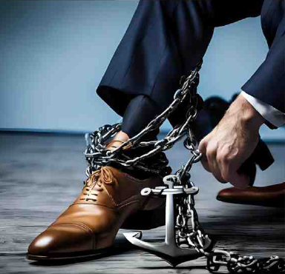
BIAS 1
THE ANCHORING BIAS
When your fast brain grabs the first number and won’t let go
The Fast Brain grabs hold of the first number presented…instantly
It sticks to the brain like industrial-strength Velcro
The Slow Brain tries but fails to sufficiently adjust away from it
Notes:
Here we go – Bias # 1 - Anchoring
Negotiation 101 tells us: he who throws out the first number controls the negotiation. [PAUSE]
You’ve probably heard this at Scotwork, or any negotiation training. [PAUSE]
That’s called Anchoring.
But do you really know just how powerful anchoring is?” [PAUSE, lean in]
Because once you see the data, you’ll never want to let the other side go first again
[CLICK – wait for content to appear]
Here’s what happens in every negotiation:
[CLICK – wait for slide]
Your opponent’s Fast Brain grabs the first number in milliseconds. [PAUSE]
[Click] That number sticks like industrial-strength Velcro. [CLICK]
[CLICK] The Slow Brain will spend the rest of the negotiation trying — and failing — to adjust away from it
You need to remember this and use it to your favour in a negotiation. Ethically, of course.
And I say ethically, because this isn’t about manipulation. This is how decisions realistically get made. [PAUSE]
Whether we like it or not, that first number will hijack everyone’s system.
So the question is: will the anchor be your number… or theirs?

Slide 13
BIAS 1
THE ANCHORING BIAS
When your fast brain grabs the first number and won’t let go
The power of the first number…
First Offers - 80% more impact than later counter-offers
Set First – 4x more likely to hit your target
0% correlation between the amount of experience and your resistance to anchoring bias
Notes:
Let’s look at the proven stats. [PAUSE]
First offers have about 80% more impact than subsequent counter-offer. So not going first is gonna hurt you[CLICK]
If you do set the first price in an RFP response or contract negotiation, you're 4x more likely to hit your target margin. [CLICK]
And here’s the scary part: no amount of experience protects you. [CLICK]
It doesn’t matter how rational, logical, or experienced you are. [PAUSE] It’s not about intelligence or training — it’s about brain wiring.
This is the Fast Brain doing what it does best – grabbing information and giving it disproportionate weight and stickiness.
Just for fun, let’s look at a couple of famous studies.
CLICK

Slide 14
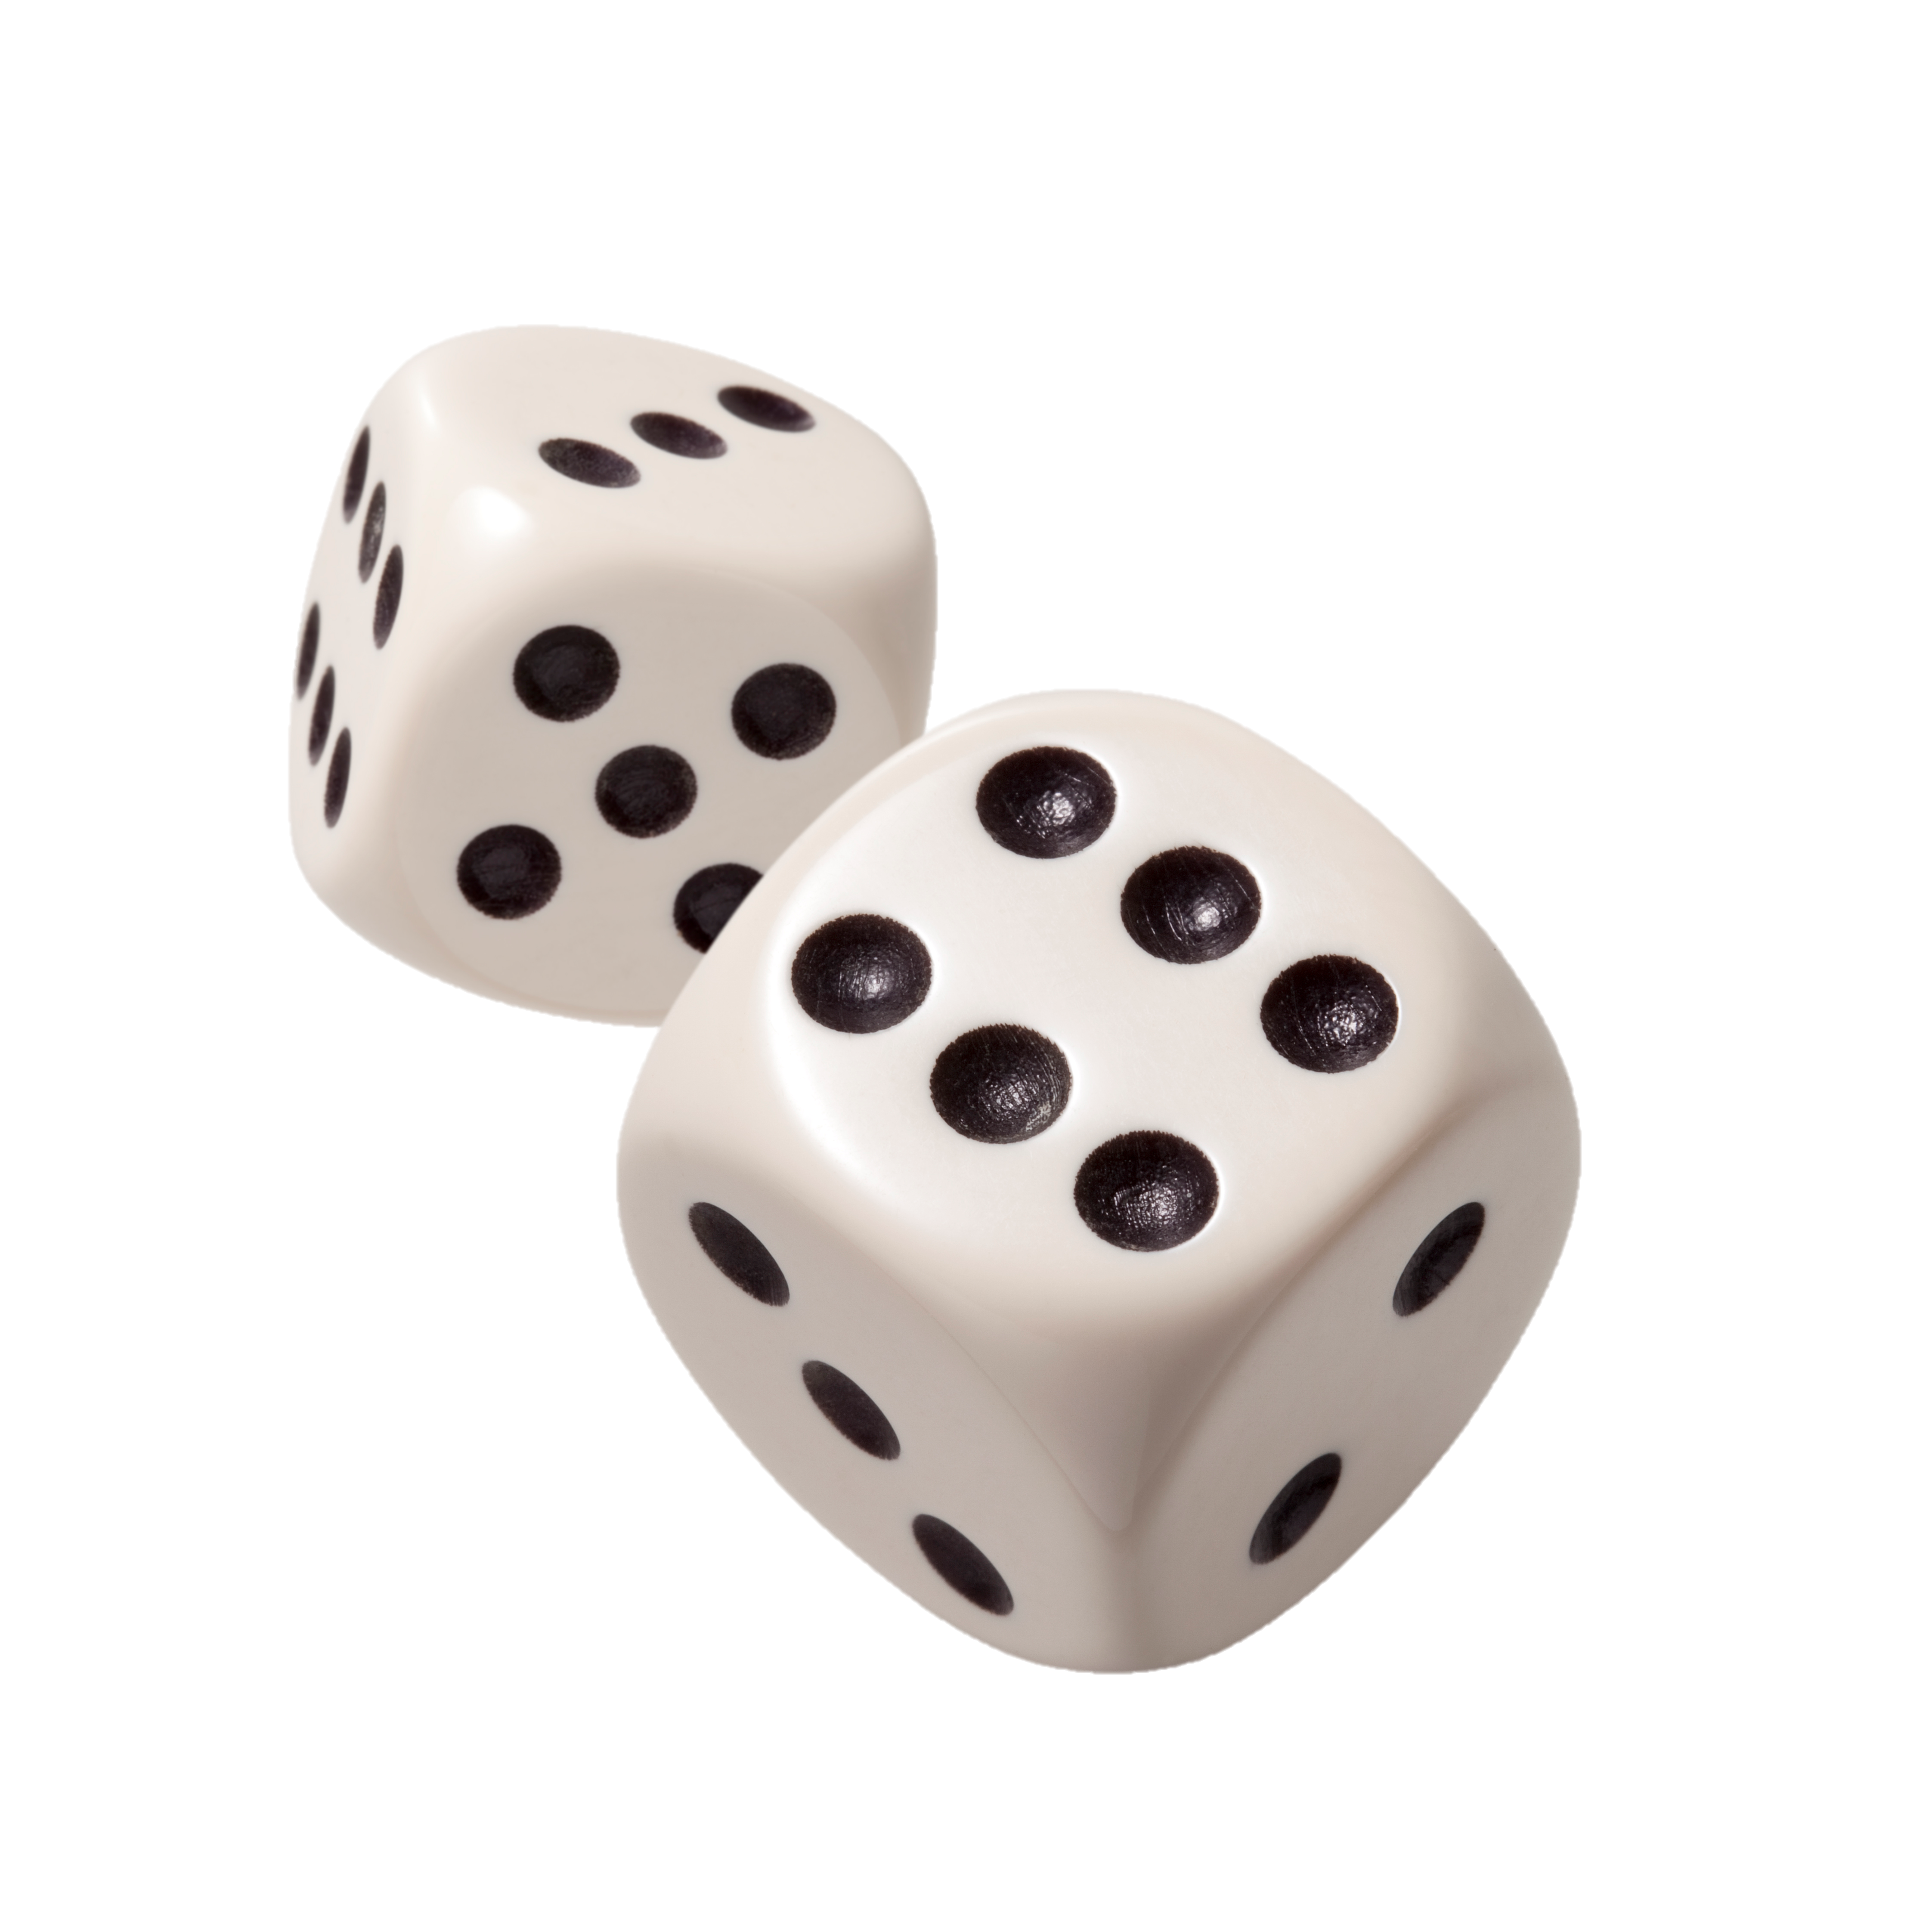

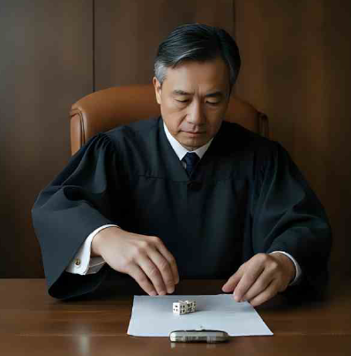
BIAS 1
THE ANCHORING BIAS
The first number is industrial-strength Velcro
Study [Englisch & Mussweiler, 2001]
Rolled a 3, sentenced to
5 months
Rolled a 9, sentenced to
8 months
Same case,
60%
longer sentences… on the roll of a dice!
How long will I sentence someone after rolling a dice?
Notes:
To test just how deep anchoring goes, researchers tested it on judges. [PAUSE]
Trained legal experts making life-altering decisions.
Each judge got the same shoplifting case.
But before sentencing, they rolled loaded dice showing either a 3 or a 9.
3 shows? Average sentence: 5 months. [PAUSE]
9 shows? 8 months. [PAUSE]
That’s a 60% increase — same crime, same evidence, same law.
This shows that the anchor can be totally irrelevant —it just needs to be first
So maybe think twice before you give your phone number out before you bid on a house at auction!

Slide 15
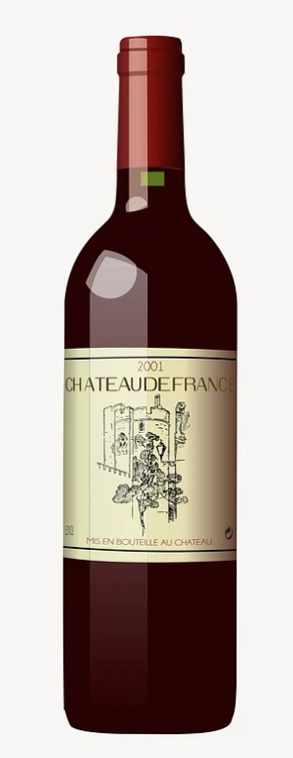
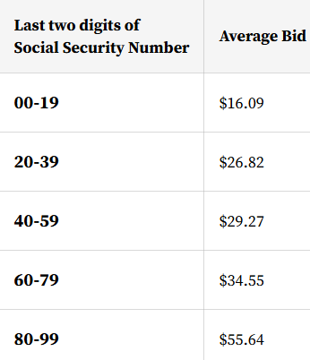
BIAS 1
THE ANCHORING BIAS
The first number is industrial-strength Velcro
How much will I pay for a bottle of wine after I write down two random numbers?
Up to 346% more
for the same
bottle of wine!
Study [Ariely, Loewenstein & Prelec, 2003]
Notes:
Now — here’s the absurd version. [PAUSE]
At MIT, students were asked to bid on bottles of wine.
But before bidding, they wrote down the last two digits of their Social Security number.
Completely irrelevant, right? [smile]
Students with higher numbers bid far more than those with lower numbers.
Same wine. Same students. Prices varied by up to 346%.
A random number — their own ID — hijacked what they were willing to pay.
So whether it’s judges sentencing criminals or students buying wine, the lesson is the same:
Your brain grabs the first number and never lets go.
CLICK

Slide 16
No one is immune to the Anchoring Bias
🎯 Relevance even random numbers anchor
🚫 Impossibility absurd numbers still work
🧠 Awareness knowing about it doesn’t protect you
💪 Motivation willpower won’t save you
🚀 Extremes the more extreme, the stronger the anchor
Industrial. Strength. Velcro
Get your extra resources here:
Notes:
The lesson from hundreds of studoes – no one is immune.
Random numbers work.
Absurd numbers work.
Even knowing about anchoring doesn't protect you
You can’t just willpower your way through it.
And here’s the kicker: the more extreme the number, the stronger the anchor. Industrial Strength Velcro

Slide 17
BIAS 1
THE ANCHORING BIAS
When your fast brain grabs the first number and won’t let go
Anchor first – whenever possible
Be bold, but not crazy
Make your anchors specific
like $176,300 instead of "around $180k”
Anchor on more than just price
(timelines, service levels, contract terms)
Break down their anchor
and then re-anchor each component
Anchoring Negotiation Tips:
Get your extra resources here:
Notes:
First, always anchor first when possible. In salary negotiations, the first number thrown out predicts the final agreement better than qualifications.
Second, go extreme but not absurd—research shows aggressive anchors work even when people know they're aggressive.
Third, make it stick with supporting details. When you anchor, precision matters. $176,300 sounds thought-through. ‘Around $180k’? That sounds negotiable
And remember, you can anchor more than just price. Lock in timelines, service levels, contract terms.
If the other side anchors first—don’t fight it head-on. Break it into pieces, and reset anchors for each one.
Anchoring isn’t just about throwing out a number. It’s about steering the entire frame of the negotiation.

Slide 18
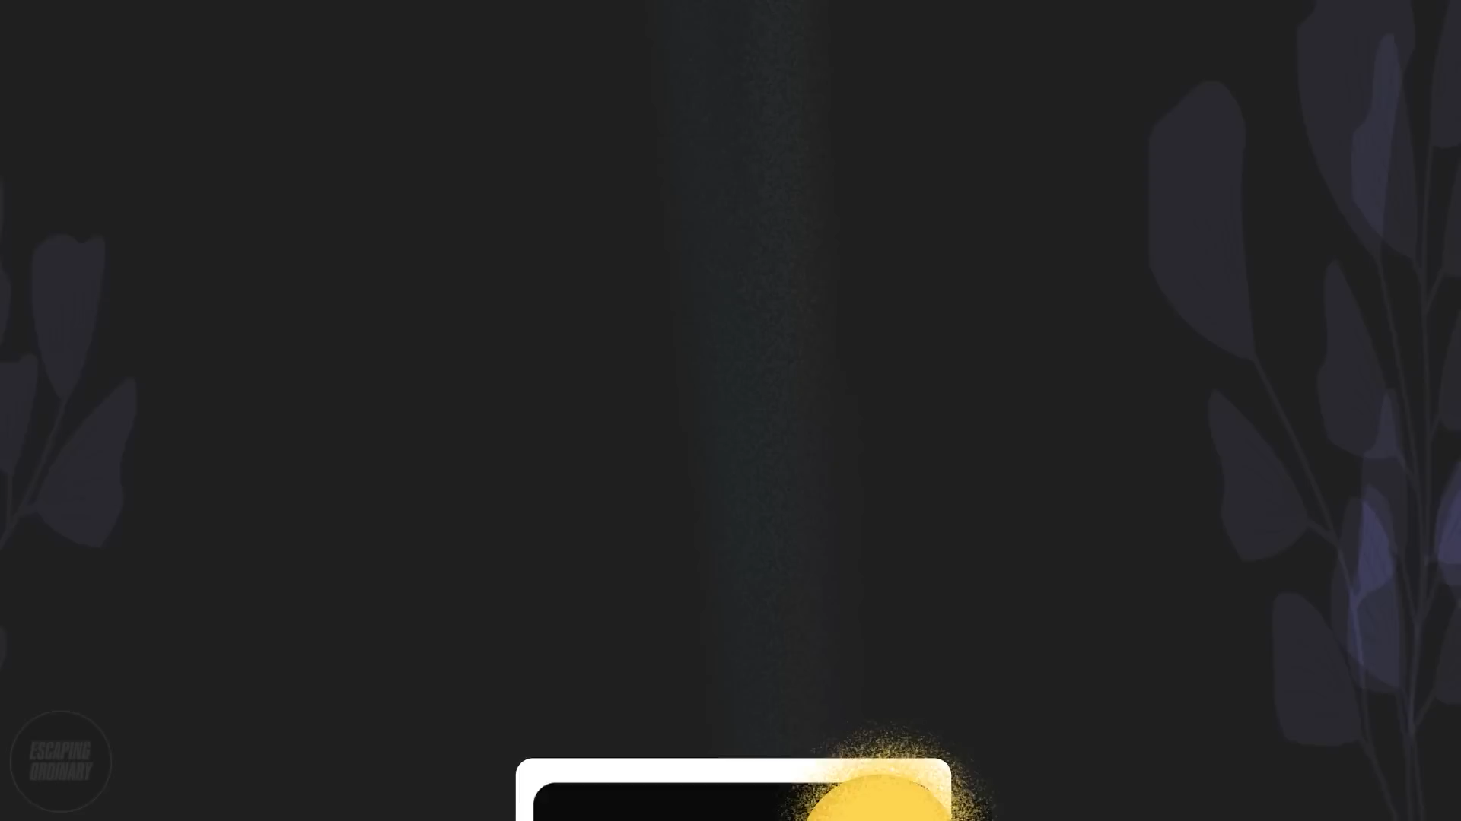
BIAS 2
THE HALO EFFECT
Sequencing Matters
Notes:
Anchoring doesn’t just apply to money — it applies to information too.
Your Fast Brain grabs the first thing it sees or hears, and everything that follows is filtered through it.
That’s the Halo Effect. [PAUSE]
Watch this quick video
CLICK

Slide 19
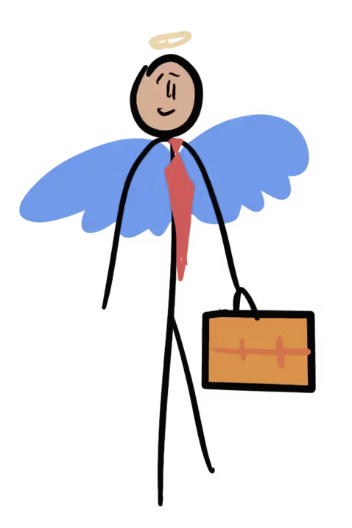
BIAS 2
THE HALO EFFECT
Sequencing Matters
First Impressions Stick – use them to your advantage
Sequence information and issues strategically
Lead with your strongest value proposition
2. Match your opening to your audience – what’s important to them?
Cost savings for procurement, compliance for government, innovation for tech companies
Negotiation tip: Control the Sequence, Control the Impression
Notes:
First impressions stick and colour everything that follows.
In negotiation, this matters. [PAUSE]
Because your counterpart isn’t weighing every detail objectively
They’re seeing everything through the lens of what their Fast Brain noticed first.
If a supplier opens with ‘we’re still fixing integration issues,’ the whole pitch feels shaky. [PAUSE]
But if they lead with ‘we’re ISO-certified, serving three agencies already, and have 24/7 resilience,’ everything that follows feels stronger. [PAUSE]
And the more specific your halo, the better it sticks -instead of saying 'we're reliable,' say
'we've never missed a deadline in 847 projects over six years.’
So remember: control the sequence, control the impression.
CLICK”

Slide 20
BIAS 3
LOSS AVERSION
We fear losses about twice as much as we value gains
Notes:
Here's a cognitive bias that can transform how you negotiate with buyers and suppliers.

Slide 21
2X
Losses are felt twice as intensely as equivalent gains
- Kahneman & Tversky, Nobel Prize winners
Notes:
If I gave you $50 you’d feel pretty good. But if you lost $50, you’d feel much worse than the happiness you got when I gave you the $50. In fact, I would have to give you $100 for you to feel neutral again.
[Pause 2 seconds]
Daniel Kahneman and Amos Tversky won the Nobel Prize for proving what you just felt in your gut. Losses don't just feel worse than gains—they feel exactly twice as bad."
[Move closer to audience]
"Think about that. Your brain literally experiences losing twenty dollars as twice as painful as the joy of finding twenty dollars. This isn't weakness—this is evolution. Our ancestors who were careless with resources didn't become ancestors."
[Pause, let it sink in]
"But here's what those Nobel Prize winners discovered that changes everything about how we should negotiate..."
[Build anticipation]
"If losses feel twice as bad, then we've been having the wrong conversation entirely."
Nobel Prize winners Kahneman and Tversky proved that losses feel exactly twice as intense as equivalent gains. – This isn’t just psychology – it’s your competitive advantage
When your supplier thinks they're losing something, that pain is twice as strong as the pleasure they'd feel from gaining the same thing. So instead of offering them more money or benefits, focus on what they stand to lose without your partnership
"Your suppliers' and clients' brains treat every contract concession like a survival threat. This changes everything about how you negotiate contracts.“
When your supplier thinks they're losing something, that pain is twice as strong as the pleasure they'd feel from gaining the same thing. So instead of offering them more money or benefits, focus on what they stand to lose without your partnership."
Practical Examples (45-60 seconds)
Example 1 - Contract Renewal:
Instead of: "We'll increase our order volume by 20%"
Frame as: "Without renewing, you'll lose 20% of your predictable revenue stream"
Example 2 - Payment Terms:
Instead of: "We offer faster payment processing"
Frame as: "Other suppliers are losing cash flow advantages while you maintain 15-day payment cycles"
Example 3 - Exclusive Partnerships:
Instead of: "You'll gain exclusive access to our market"
Frame as: "Your competitors will lose the opportunity to serve our 50,000 customers"
Slide 27: [Replace generic text with: "Instead of 'We'll extend the contract term,' say 'Don't lose out on these locked-in rates for three years.'"]
"Instead of saying 'This contract will generate 20% more revenue,' say 'Don't lose this 20% revenue opportunity to competitors.' Same contract terms, double the psychological impact."

Slide 22
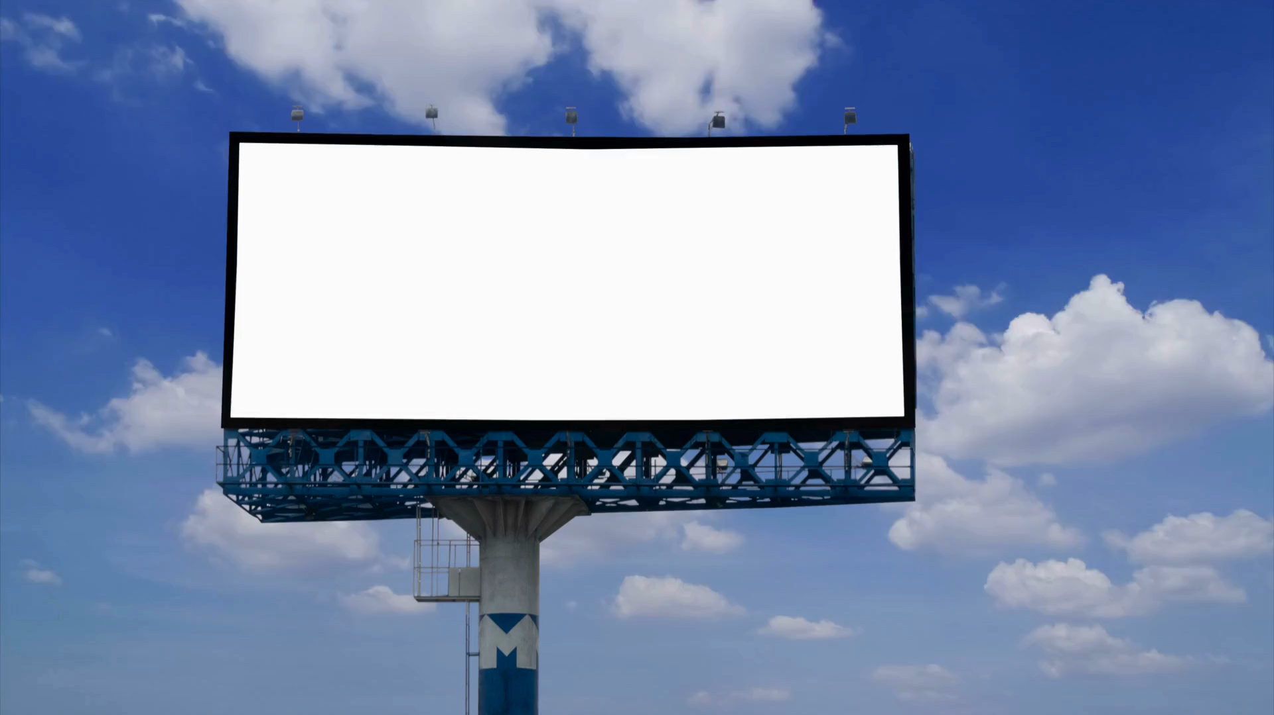
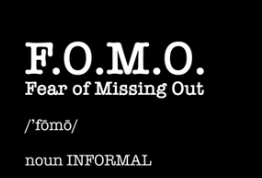
LOSS AVERSION TACTICS IN MARKETING
Notes:
Marketers use Loss Aversion (or FOMO) on us daily - weaponizing our fear of loss to drive consumer behaviour.
It works because your brain is hardwired to avoid loss before it ever chases gain. [PAUSE]
CLICK

Slide 23
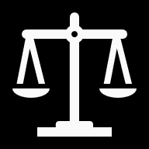


USING LOSS AVERSION IN NEGOTIATION
The Core Principle Losses feel twice as intense as equivalent gains.
Concessions hurt 2x more than they are valued
Present your concessions as minimising losses instead of providing gains to increase their value to the other side.
Use the Status Quo Bias →
Emphasize the costs or losses associated with inaction
Certainty effect →
Make advantages definite and risks uncertain
Notes:
Slide Headline Options
“Concessions hurt 2x more than they’re valued.”
“Your pain of giving > Their joy of receiving.”
“Concessions = asymmetric loss.”
“Every concession feels twice as heavy as it looks.”
“In concessions, loss shouts louder than gain.”
So here's where loss aversion becomes your negotiation superpower. [PAUSE] The core principle is simple but profound: losses feel twice as intense as equivalent gains. This isn't weakness—it's how every human brain is wired.
[POINT TO SCALES ICON] Let's start with concessions. This is the big one that most negotiators get wrong. When you give up something in a negotiation, it hurts you twice as much as it benefits them. That $10,000 discount you just offered? It feels like a $10,000 loss to you, but only a $5,000 gain to them. [PAUSE] So here's the key: present concessions as minimizing their losses instead of providing gains. Instead of saying "We'll include free training" (sounds like a nice-to-have bonus) try saying "This protects you from the $8,000 learning curve costs that come with switching systems" (frames it as avoiding a painful, inevitable loss). Same number, completely different psychological impact.
[POINT TO SHIELD ICON] When you're making demands, remember that demands create resistance. Your brain's autopilot sees demands as threats, as potential losses. So instead of introducing new losses—'You need to pay more for premium support'—focus on limiting their potential benefits. 'Without premium support, you're capped at basic response times.' You're not taking something away; you're showing them what they won't get.
[POINT TO HOURGLASS ICON] Status quo bias is loss aversion's cousin. People stick with what they have because changing feels like losing what's familiar. [PAUSE] But here's the trick: emphasize the costs of inaction. 'Every month you stay with your current system, you're losing efficiency to competitors who've already upgraded.' You're not asking them to lose their current system—you're showing them they're already losing by keeping it.
[POINT TO GIFT ICON] The offer-asking gap is fascinating. When there's uneven value exchange, the person receiving less feels the imbalance more intensely than the person receiving more feels the benefit. [PAUSE] So if you're offering something worth $100 for something worth $80, that $20 gap feels bigger to them than the $80 value feels good to you.
[POINT TO LOCK ICON] Finally, the certainty effect. People overweight certain outcomes compared to probable ones. Make your advantages concrete and definite—'This guarantees 15% cost reduction'—while making their risks feel uncertain—'Your current approach might work, but market trends suggest...'
[PAUSE] The beautiful thing about loss aversion is you're not manipulating anyone. You're helping their autopilot brain process the true cost of their situation the same way yours would. You're creating alignment, not deception."
Here’s where loss aversion gets powerful in negotiation. People fight harder to avoid losing money, status, or reputation than they do to gain the same amount. That’s why ‘You’ll lose $10k if you delay’ hits harder than ‘You’ll save $10k if you act.’ Same number, totally different reaction.
And this plays out in concessions. Every time you give something up, it hurts you about twice as much as the other side values it — and vice versa. That’s why concessions always feel unfair, and why they’re such sticking points. The trick is: make concessions visible so the other side feels them more, frame them as losses avoided if they don’t accept, and most importantly — trade, don’t give away — because once you’ve conceded, you can’t claw back that sense of loss.
OR
In negotiation, this is incredibly powerful. People fight harder to avoid losing money, status, or reputation than to gain the same. That’s why phrasing matters: ‘You’ll lose $10k if you delay’ hits harder than ‘You’ll save $10k if you act.’ The numbers are identical, but the reaction is completely different.
In negotiation, loss aversion shows up in concessions. Every time you give something up, it hurts you twice as much as the other side values it. And of course, the same is true for them. This is why concessions feel so lopsided — and why negotiators often get stuck.
The trick is to:
Make concessions visible so the other side feels them more.
Frame them as losses for them if they don’t accept (‘If we move past this, you lose X’).
Trade, don’t give away — because once you’ve conceded, you can’t claw back that sense of loss.”
OR
In negotiation, concessions are emotional math, not financial math. Loss aversion means your side feels the pain at double intensity, while the other side barely registers the gain. That’s why concessions feel unfair — and why skilled negotiators make them visible, frame them as losses avoided, and always trade rather than give.”
1. Concessions feel bigger than gains “When you give something up, it hurts twice as much as it pleases the other side to receive it. So instead of presenting it as a gift, frame it as preventing a loss – that feels more valuable to them.”
2. Demands create resistance “Demands sting if they push someone into a loss zone. Instead, make demands in areas where they’re already winning – you trim their upside a little rather than dragging them below zero.”
3. Status quo bias “People cling to the current situation, even if it’s costly. Show that standing still has hidden losses – that the status quo will erode anyway – and suddenly change looks less risky.”
4. Offer-asking gap (Endowment effect) “We all overvalue what we already have. The trick is to trade on differences in value – give away what costs you little but means a lot to them. That narrows the painful gap.”
5. Certainty effect “People pay extra for certainty. If you can make benefits guaranteed and losses look less certain or reversible, you shift the balance in your favour.”

Slide 24
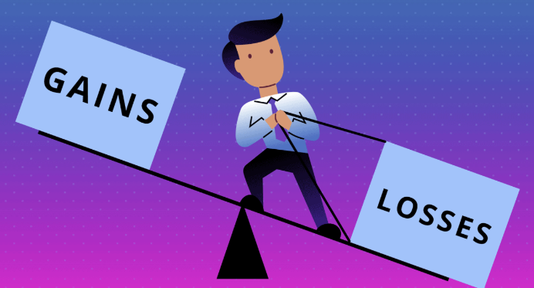
LOSS AVERSION & CONCESSION TRADING
Because losses are felt twice as intensely as equivalent gains, concession trading never feels fair.
Your concession hurts you 2x more than it is valued by other side
Negotiation Tip
Make your concessions work for you:
Check the real value — not just how it feels
Make your concessions feel more valuable to the other side by framing them as reduction in loss, not an increase in a gain
Notes:
"Here's why contract concession trading never feels fair - your pricing concession hurts you twice as much as it benefits them. So always check the real financial value, not just how the concession feels. And frame your contract benefits as protecting them from loss, not giving them gains."
Here’s why loss aversion is such a problem in negotiation.
We all know the drill – they ask for something, we ask for something, and then the game of concessions begins
The problem is, loss aversion makes concessions lopsided.
a $100k concession feels to you like losing $200k. [PAUSE] But to them, it only lands as a $100k gain — and usually with far less intensity.
This has been studied in depth — especially at Harvard’s Program on Negotiation. [PAUSE]
The fix? First, check the real value of what you’re conceding, not just how it feels. [PAUSE]
Second, frame the benefit of your concession in a way that reduces loss - because their brain wants to avoid loss just as much as yours does. [PAUSE] "Instead of saying 'We'll give you 20% more business,' say 'Don't lose this 20% revenue opportunity.'
That way, your concession feels bigger to them — and less painful to you.“
FIND AN EXAMPLE Instead of saying, ‘You’ll gain $10k,’ say, ‘If you delay, you’ll lose $10k.’ Same number — but their brain hears the loss twice as loudly.
Remember: highlight what they'll lose, not what they'll gain. The psychological impact is literally double. This reframes every concession as protection rather than acquisition—and protection always feels more urgent
In your next negotiation, don't tell them what they'll gain. Tell them what they'll lose. Because loss isn't just twice as powerful—it's twice as persuasive

Slide 25


Slide 26
MASTERING
CHOICE ARCHITECTURE!
Designing Choices changes the choices people make
Notes:
By now, we’ve seen how biases like anchoring and loss aversion skew decisions.
But here’s the flip side: you’re already shaping choices, whether you intend to or not. That’s what we call choice architecture.

Slide 27
You are already a
CHOICE ARCHITECT!
Their brain wants the easy path – design it for them
WHAT IT IS
The deliberate design of how choices are presented to influence outcomes
WHY IT MATTERS
Small tweaks shift big decisions
IT’S EVERYWHERE
Shapes health, finance, and consumer choices
Powers everything from tax systems to Netflix
The next set of Cognitive Biases work together as Choice Architecture.
Notes:
Anchoring and loss aversion are the big biases in negotiation.
But the real game-changer is choice architecture.
You are already a choice architect.
Every time you frame a choices — like what to eat for dinner, you’re presenting options in a way that shapes decisions.
Richard Thaler’s Nobel Prize work proved tiny changes in how choices are presented can massively shift outcomes.
And it’s now a huge profession – and one I find really fascinating
The next biases will show you how to architect choices to nudge decision makers.

Slide 28
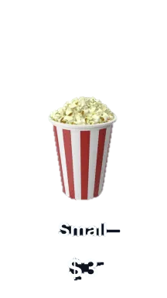
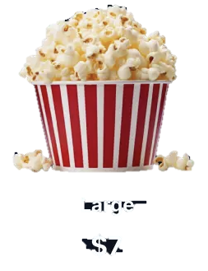
Choice Architecture
USING THE DECOY EFFECT
Control the comparison, Control the Choice
30%
70%
Get your extra resources here:
Notes:
Our fast brain makes quick decisions by comparing to a baseline.
We don’t evaluate choices in isolation—we judge them relative to what’s next to them.
The classic POPCORN Study shows this – it’s classic choice architecture in action
You’re going to the movies and there’s 2 sizes of popcorn availalable.
Most people choose small
CLICK

Slide 29
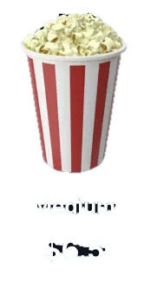
Choice Architecture
THE DECOY EFFECT
Control the comparison, Control the Choice
21%
5%
74%
Notes:
But add a decoy - medium popcorn for $6.50, and suddenly the large looks like a really good bargain.
The medium was never meant to sell—it exists solely to make the large irresistible.
CLICK

Slide 30
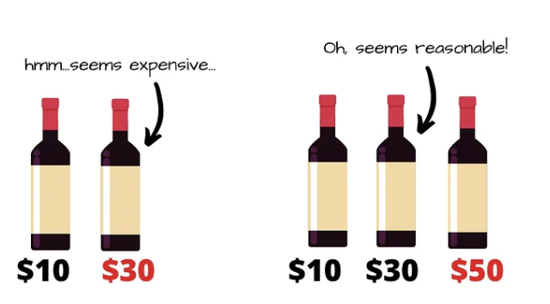
Choice Architecture
THE DECOY EFFECT
Control the comparison, control the Choice
Negotiation tips:
Our brains compare relatively, not absolutely.
Adding a third, less attractive option nudges the decision made towards your target option.
Be aware of decoys used against you – evaluate options carefully.
Notes:
You can use this the decoy effect in a negotiation, the same principle applies. [PAUSE] And the decoy doesn’t have to nudge only towards the more expensive product
Suppose you want them to pick your mid-tier package. You show three options:
stripped-down basic,
your preferred mid-tier,
and a premium that’s only slightly better but much pricier.
Suddenly the mid-tier feels like the smart, balanced choice. [PAUSE]
The decoy doesn’t just shape preference — it makes the outcome feel obvious.
But it can also be used to break a stalemate.
CLICK

Slide 31
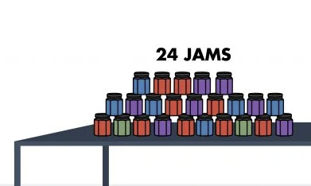
Choice Architecture
Fewer Choices = More Decisions
The Paradox of Choice
60%
of shoppers stopped to sample
2
flavours sampled on average
3%
of shoppers bought jam
Get your extra resources here:
Study: [Iyenger & Lepper, Stanford & Columbia, 2000]
Notes:
Now, decoys show us how adding one option can steer people. But what happens when there are too many options?
More choice isn't better - it's paralyzing. When we overwhelm people with options, they freeze.
In a famous study: 24 jam flavours were offered.
60% of shoppers stopped to sample.
But only 3% actually bought.
CLICK
.

Slide 32
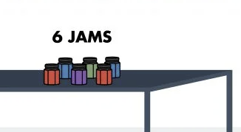
Choice Architecture
Fewer Choices = More Decisions
The Paradox of Choice
40%
of shoppers stopped to sample
2
flavours sampled on average
30%
of shoppers bought jam
60%
of shoppers stopped to sample
2
flavours sampled on average
3%
of shoppers bought jam
10 X more sales!
Notes:
When the choice set was reduced to just 6 jams:
40% of shoppers stopped,
But 30% actually bought.
Same products. Fewer choices. Ten times more sales. [PAUSE]
That’s 10 times more decisions!
CLICK

Slide 33
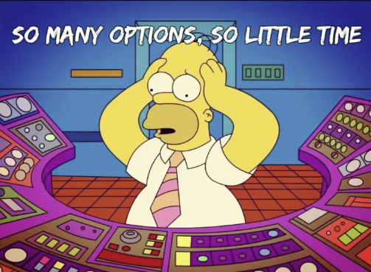
Choice Architecture
THE PARADOX OF CHOICE
Guide them to clarity
Negotiation tip:
Minimise # choices available to drive faster decisions.
Too many options → leads to decision paralysis
Fewer, structured choices → leads to action
Simplify the menu → to drive decisions
Get your extra resources here:
Notes:
When the brain faces too many options, the fast brain freezes — it avoids deciding and often just leaves the task altogether
In negotiation, too many options stall the deal.
The solution isn’t to give more choice, it’s to have choice architecture
If you present 10 variations, the other side freezes. [PAUSE]
But 2–3 clear, well-framed options? They’ll pick one.
Become a simplification expert - reduce the clutter, shape the menu, and you control the outcome.
You’ve felt this yourself — like buying a car or choosing what to watch on Netflix.
How much easier if someone gave you just three choices?
CLICK

Slide 34
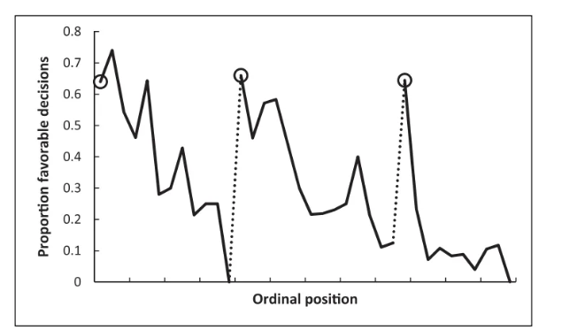
Chance of getting parole
Order of hearing
Notes:
This study should terrify every one of us.
This 2011 study included over 1000 judicial rulings, collected over 50 days
It shows the chance of prisoners being granted parole, against the order in which their cases were heard
Early cases, 65% approval. [PAUSE] Then it drops... almost to zero.
And same again – starts high, 65% and drops to below 10%
And again starting high and dropping to almost zero.
See those dotted lines? [gesture to graph]
I bet you can guess what they are. [PAUSE]
Morning tea and lunch. Right after breaks, approvals shot back up - then collapsed again.
Same judges, same cases, different time of day.
The only thing that changed? The judges' mental energy.
Life-changing decisions weren't based whether someone had just had a break
That's decision fatigue. You know it happens - but are you actively guarding against it?
CLICK

Slide 35
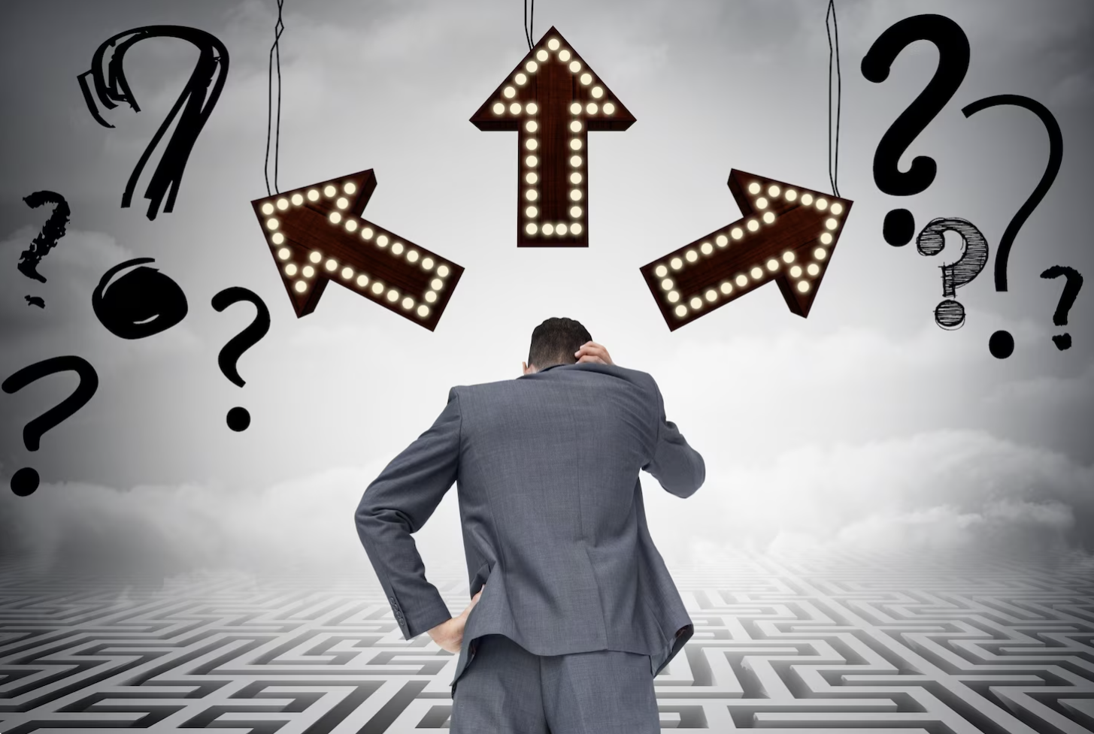
Choice Architecture
DECISION FATIGUE
When Mental Energy Runs Out
Negotiation tip:
Frontload your priorities:
Table your key asks early – before fatigue results in a default “No”
The Slow Brain tires - Fast brain seeks cognitive ease
Defaults to “NO” - Status Quo bias kicks in
Timing = everything -Fresh minds make better deals
Notes:
When our mental energy depletes, we default to the safest, easiest choice - which is usually 'no.’
That’s the Status Quo bias – our preference to not change anything because we prefer cognitive ease
This is why consciously timing your issues is critical.
Fresh minds make better deals.
If you're negotiating all day, front-load your priorities.
Schedule your most important negotiations for morning.
Save routine items for afternoon.
Because by 4 PM, even reasonable requests feel risky to a fatigued brain.

Slide 36
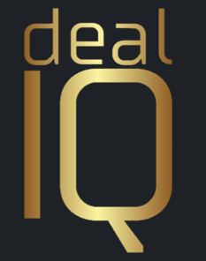



It’s a Wrap!
HOW TO SWITCH ON THE SLOW BRAIN
Notice biases in yourself and others
Real-time bias detection
Take your time on important decisions
Biases thrives on speed
Seek outside opinions –
Black Hat – Fresh eyes see more
Question your first instinct
It's usually the fast brain
Do some hard math in your head
Switches on the Slow Brain
Practice deliberately
Apply these tools consistently
www.dealiq.co.nz
priya@dealiq.co.nz
Thank you!
Questions and discussions
For a whole heap of resources -
Scan here:
Notes:
It’s a wrap
We’ve spent this morning understanding how and why the Fast Brain hijacks your rational decision making.
We’ve looked at a few key Biases and uncovered some secret tips to leverage these in a negotiation
You can’t eliminate biases — but you can spot them, manage them, and even use them to your advantage.
These aren't just academic concepts - they're practical tools that can transform your negotiation outcomes starting today. But
What questions do you have about applying these in your specific situation?"
____________________________________________________________________________________
Here’s the challenge for you as negotiators:”
Notice your cognitive biases — they’re always running in the background.
Watch others — you’ll see these biases in play across the table today.
Pause before reacting — give your slow brain a chance to switch on.
Seek the Opinion of others - Fresh eyes see clearly
Question your first instinct — ask, “Why do I think this?”
Practise deliberately — the more you notice them, the more you can defend yourself.
“Try to catch one in action today.”

